Slide 1
A GIFT OF FIRE THIRD EDITION - SARA BAASE
CHAPTER 2: PRIVACY
Lecture 1
Privacy and Computer Technology
Syada Tasmia Alvi
Lecturer, Dept.of CSE
Daffodil International University

Slide 2
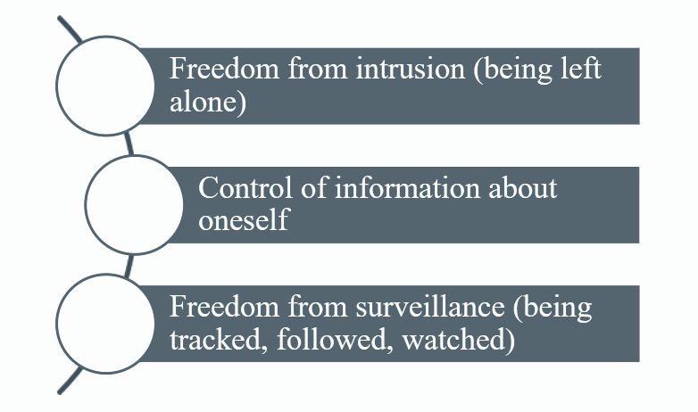
PRIVACY AND COMPUTER TECHNOLOGY
Three Key Aspects of Privacy:

Slide 3
PRIVACY RISKS AND PRINCIPLES
Privacy threats come in several categories:
Intentional, institutional uses of personal information
Unauthorized use or release by “insiders”
Theft of information
Inadvertent leakage of information
Our own actions

Slide 4
PRIVACY AND COMPUTER TECHNOLOGY
New Technology, New Risks:
Government and private databases
Thousands of databases containing personal information about us.
Profiles of our personal information could be created easily.
Sophisticated tools for surveillance and data analysis
Cameras, GPS, cell phones
Vulnerability of data
Leaks of data happens, existence of data presents a risk.

Slide 5
PRIVACY RISKS AND PRINCIPLES
New Technology, New Risks – Examples:
Search query data
Search engines collect many terabytes of data daily.
Data is analyzed to target advertising and develop new services.
Who gets to see this data? Why should we care?
Smartphones
Location apps
Data sometimes stored and sent without user’s knowledge

Slide 6
PRIVACY RISKS AND PRINCIPLES
New Technology, New Risks – Summary of Risks:
Anything we do in cyberspace is recorded.
Huge amounts of data are stored.
People are not aware of collection of data. Software is complex.
Leaks happen.
A collection of small items can provide a detailed picture.
Re-identification has become much easier due to the quantity of information and power of data search and analysis tools.

Slide 7
PRIVACY RISKS AND PRINCIPLES
New Technology, New Risks – Summary of Risks:
If information is on a public Web site, it is available to everyone.
Information on the Internet seems to last forever.
Data collected for one purpose will find other uses.
Government can request sensitive personal data held by businesses or organizations.
We cannot directly protect information about ourselves. We depend upon businesses and organizations to protect it.

Slide 8
PRIVACY AND COMPUTER TECHNOLOGY (CONT.)
Terminology and principles for data collection and use:
Invisible information gathering
Collection of personal information about someone without the person’s knowledge
Unauthorized software, Cookies, ISP providers •
Secondary use
Use of personal information for a purpose other than the one it was provided for .
Data mining
Searching and analyzing masses of data to find patterns and develop new information or knowledge
Computer matching
Combining and comparing information from different databases (using social security number, for example, to match records)

Slide 9
Computer profiling
Using data in computer files to predict likely behaviors of people
Analyzing data in computer files to determine characteristics of people most likely to engage in certain behavior
Businesses find new consumers
Government detects fraud and crime activities
Businesses engage in profiling to determine consumer propensity toward a product or service.
Government agencies use profiling to create descriptions of possible terrorist

Slide 10
Principles for Data Collection and Use:
Informed consent
Opt-in and opt-out policies
Fair Information Principles (or Practices)
Data retention - Data retention is the storing of information for a specified period.

Slide 11
Principles for Data Collection and Use:
Informed consent :
People should be informed about the data collection and use policies of a business or organization,
They can then decide whether or not to interact with that business or organization.
Opt-in and opt-out policies :
Opt-in :
Opting in means that a user will take an affirmative action to offer their consent.
The most common way businesses implement opt-in methods is through checkboxes. When presented with a checkbox, the user must take action to check the box, which denotes their consent.

Slide 12
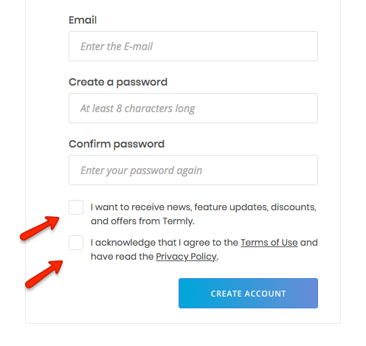
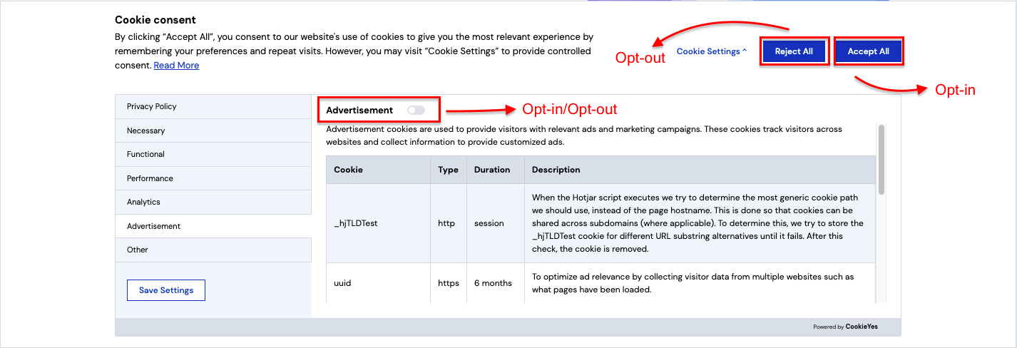
Principles for Data Collection and Use:
Opt-in policies:
Opting in can be used in a variety of situations, including subscribing to email and newsletter mailing lists, accepting cookie use, and agreeing to legal policies.

Slide 13
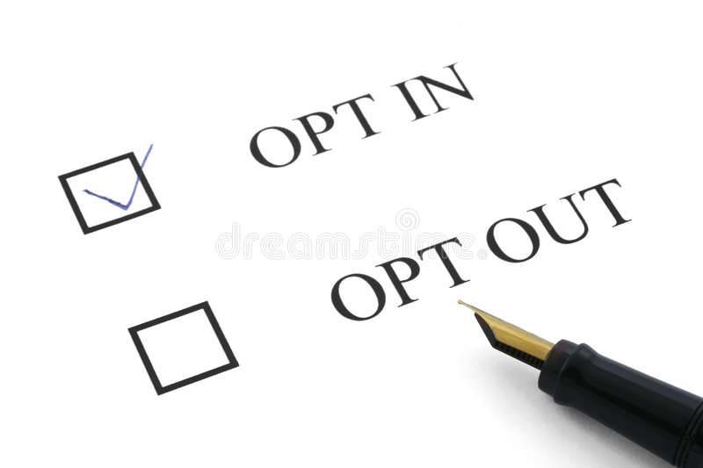
Principles for Data Collection and Use:
Opt-out policies :
Opting out means a user takes action to withdraw their consent.
Not choosing to subscribe to newsletters, unticking a previously ticked checkbox, not consenting to save personal details, rejecting the use of cookies, etc. are some examples of opt-out.

Slide 14
Principles for Data Collection and Use:
Fair Information Principles (or Practices)
Inform people when you collect information about them, what you collect, and how you use it.
Collect only data needed
Offer a way for people to opt out from mailing lists, advertising, and other secondary uses.
Offer a way for people to opt out from features and services that expose personal information.
Keep data only as long as needed
Protect security of data (from theft and from accidental leaks). Provide stronger protection for sensitive data.
Policies for responding to law enforcement

Slide 15
Thank You

